Slide 1
What I looked at
558,811 car auction records
Total money made
$7.6 billion
Average car price
$13,611
Profit margin (not great)
-15.1% on average
Car Sales
Data Project
I looked at over 558,000 car sales
from late 2014 to mid 2015
Rinae Netshilinganedza

Slide 2
The Big Numbers
Total Sales
558,799
cars sold at auction
Money Made
$7.6B
in total sales revenue
Avg. Car Price
$13,611
per car on average
Avg. Profit Margin
-15.1%
yikes, below market price
The surprising part: More than half of all the cars sold for LESS than what they were worth. So on average people were losing about 15 cents for every dollar

Slide 3
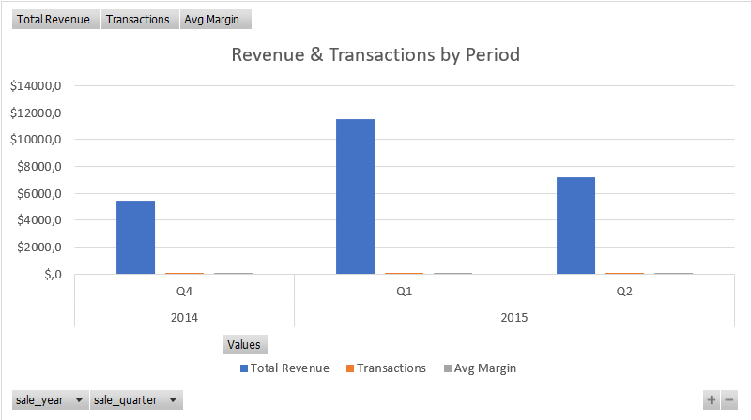
Sales by Quarter - When Was Everyone Buying?
Sales Broken Down by 3-Month Period
Oct-Dec 2014
53,520 sales | $604M | -13.9% margin
Jan-Mar 2015 ★ BUSIEST by far
349,938 sales | $4.7B | -18.2% margin
This one quarter = 62% of all the money!
Apr-Jun 2015
153,834 sales | $2.3B | -8.5% margin
Jul 2015 (only part of Q3)
1,300 sales | $22M | -9.9% margin
Chart from my Excel dashboard (you can filter it by state, car type, year)

Slide 4
Which Car Brands Made the Most Money?
Ford
$1.36B
Chevrolet
$723M
Nissan
$634M
Toyota
$489M
BMW
$447M
Interesting thing I noticed: Ford sold almost twice as many cars as Chevy. But BMW made $447M with only 21K cars — that's way more per car than Ford. Expensive cars = less volume but bigger checks.

Slide 5
Where Are People Buying Cars?
Florida (FL)
$1.15B
California (CA)
$1.06B
Pennsylvania (PA)
$861M
Texas (TX)
$606M
Georgia (GA)
$449M
Wild: Just four states — Florida, California, Pennsylvania, and Texas — made up almost half (48%) of all the money in the whole dataset. So if you want to sell cars, those are the places to be.

Slide 6
5 Things That Stood Out to Me
01
The first three months of 2015 had more sales than any other time —6 times more than the last part of 2014
02
More than half the cars sold for less than they were actually worth.
03
Florida and California were way ahead of every other state
04
Ford completely dominated — they sold almost twice as many cars as Chevy who came in second.
05
BMW sold way fewer cars than Ford but still made profit because of Car costs.

Slide 7
What I Think They Should Do
Look into why Jan-Mar 2015 blew up
That was 62% of all the sales in 8 months — there has to be a reason. If they figure it out they could be ready for it next time
Don't let people pay too little
If I was the owner I'd set a floor price so no car can sell for less than what it's worth
Put more effort into Florida and California
Those two states alone made up 29% of all the money. It just makes sense to sell more cars where people are already buying them
Sell more expensive cars
Luxury cars like BMW and Mercedes made more per sale.
Use the data to plan ahead
Since we can now see which months are busy, someone could look at the patterns and have more cars ready before the sales go up.

Slide 8
Thanks!
Car Sales Data Analysis Project
558,811 car sales looked at | Dec 2014 to Jul 2015
Data from: R_Netshilinganedza_CareSales.xlsx

